Slide 1
Extractive Summarization of Bangla Documents by Fine Tuning BERT Models
Group 12
Mosarrat Rumman 20266007
Abu Nayeem Tasneem 20266002
Israt Jahan Ritun 21166038
Junaid Bin kibria 21166022
CSE 713 Submission 6
Paper submitted at
https://icaart.scitevents.org/

Slide 2
Introduction
Motivation
Summarizer helps to focus on key points in a document
Very few works have been done in Bangla Summarizer
Two types summarizer abstractive and extractive. We focused on extractive
Dataset : Bengali News Summarization dataset built by Bhattacharjee et. al in their paper “Bengali Abstractive News Summarization(BANS): A Neural Attention Approach”

Slide 3
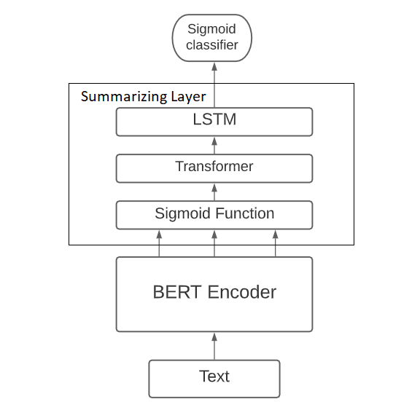
Proposed method
we insert a [CLS] token before each sentence and a [SEP] token after each sentence.
The [CLS] is used as a symbol to aggregate features from one sentence or a pair of sentences.

Slide 4
Evaluation
ROUGE, or Recall-Oriented Understudy for Gisting Evaluation,

Slide 5
Thank you

